Slide 1
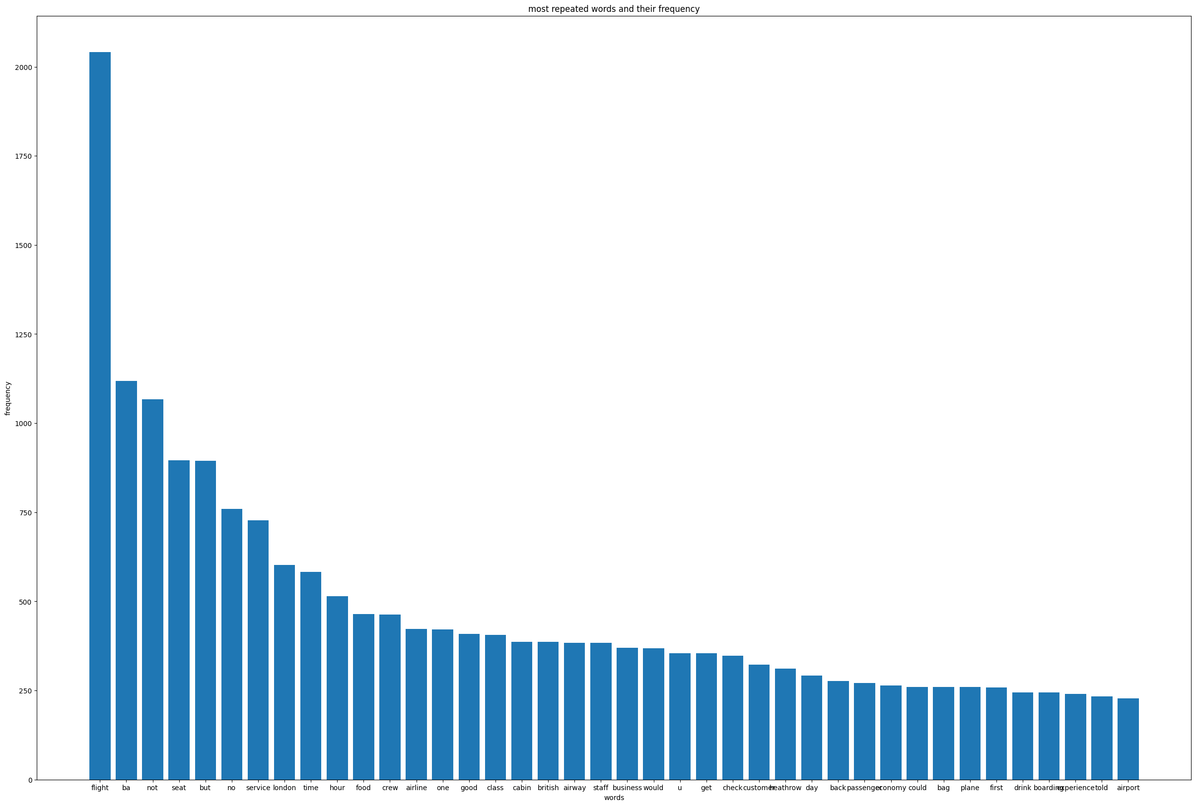
BRITISH AIRWAYS
customer feedback and reviewing
Most repeated words with their frequencies

Slide 2
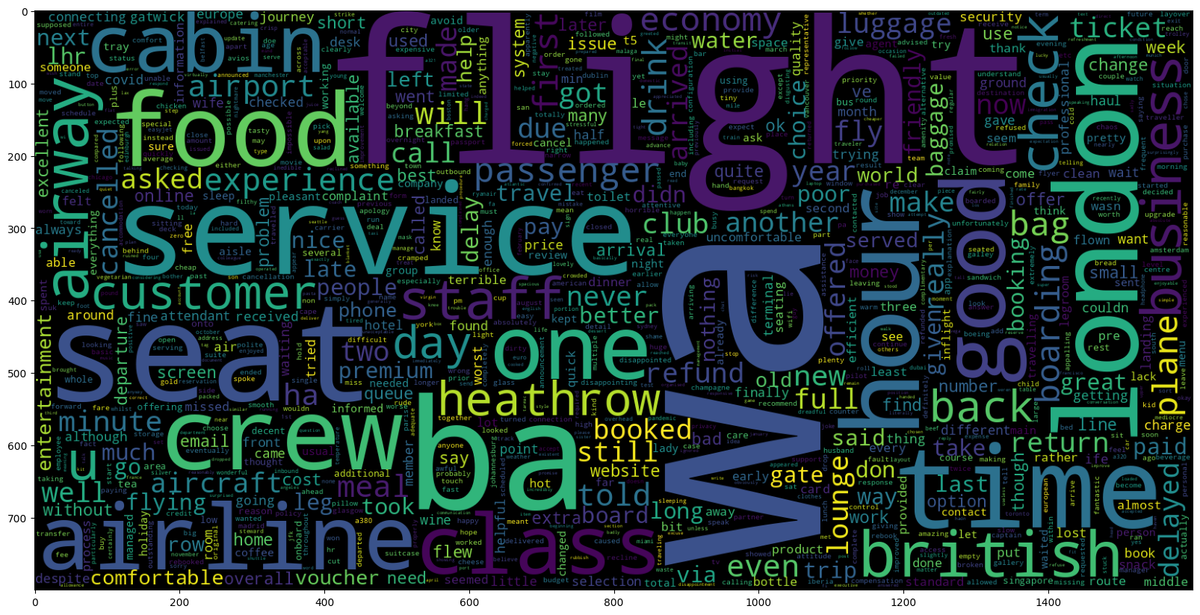

Word cloud represents the words in the reviews after preprocessing the text.
positive reviews-0.347 negative reviews-0.603 neutral reviews-0.05

